Slide 1

Epileptic Seizure Recognition
Presented by : ZIYAD Mohssine, ZOGARH Meriem, OUKASSOU Youssef
Supervised by : Prof. QUAFAFOU Mohamed

Slide 2
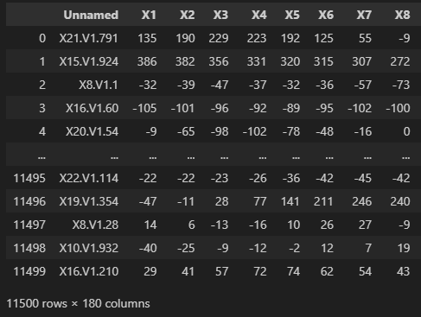
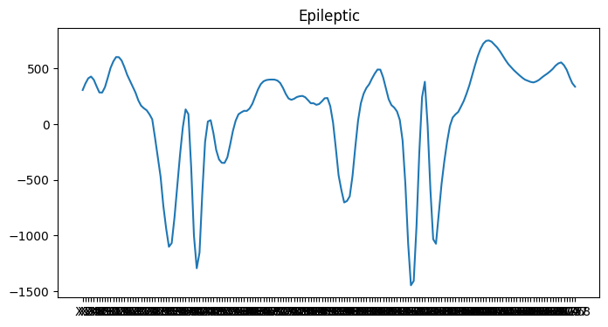
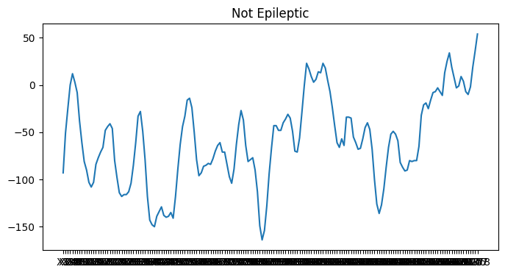
EEG RECORDING AT DIFFERENT POINT IN TIME
PATI
ENTS
5 - recording when the patient had their eyes open
4 - recording when the patient had their eyes closed
3 - The patient has a tumor in the brain, recording from the healthy brain area
2 - recording from the area where the tumor was located
1 - Recording of epileptic seizure

Slide 3
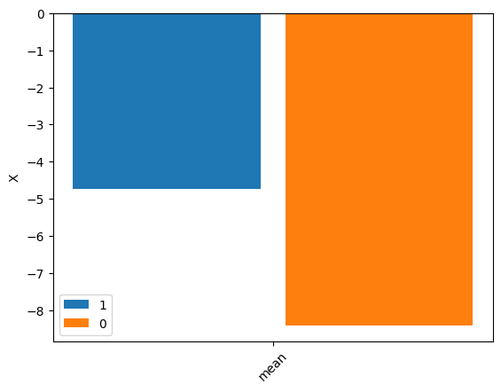
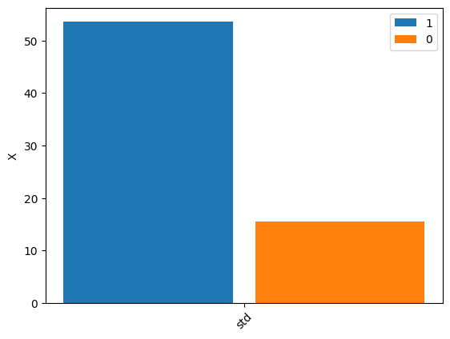
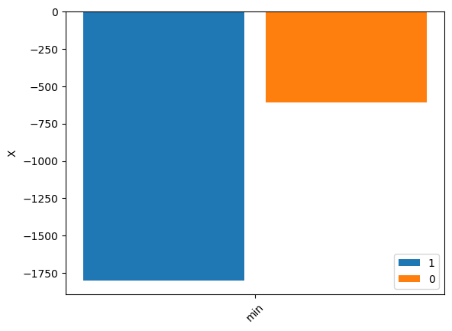
Class 1 (subjects with epileptic seizure)
9200
0
Class 0 (subjects falling in classes 2, 3, 4, and 5 are those who do not have epileptic seizure)
2300
1

Slide 4
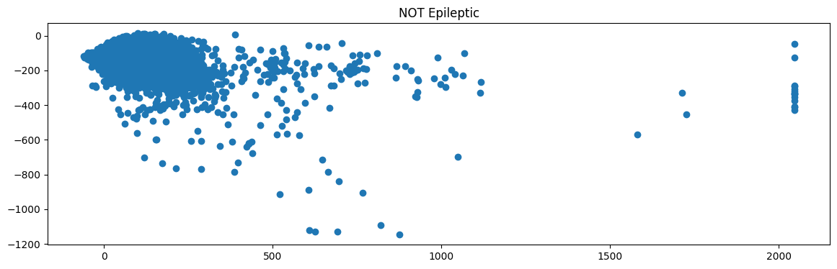
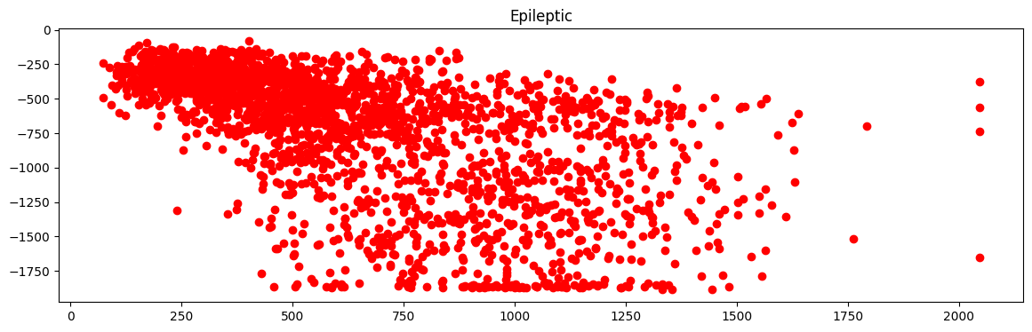

Slide 5
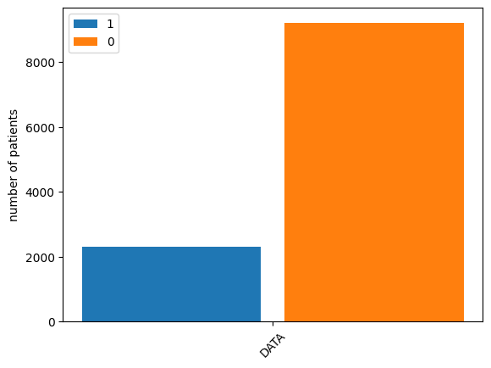
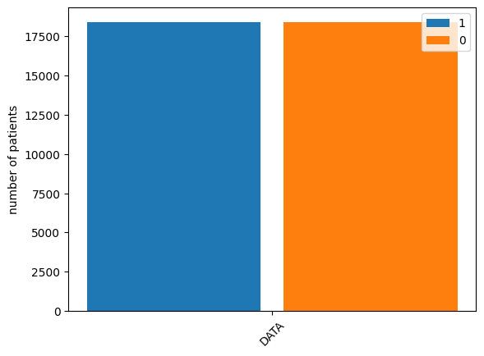
Oversampling
70% :
Training
20% : Testing
80% :
Oversampling
30% : Testing

Slide 6
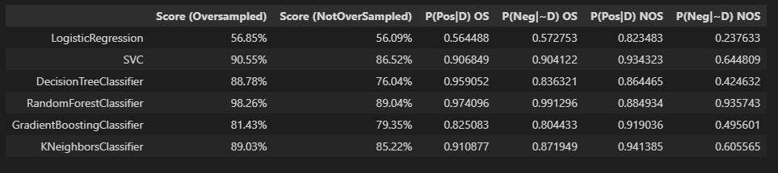
Training + Testing
P(Pos|D) OS: the probability of a positive test given that the patient has the disease
P(Neg|~D) OS: the probability of a negative test given that the patient is well

Slide 7
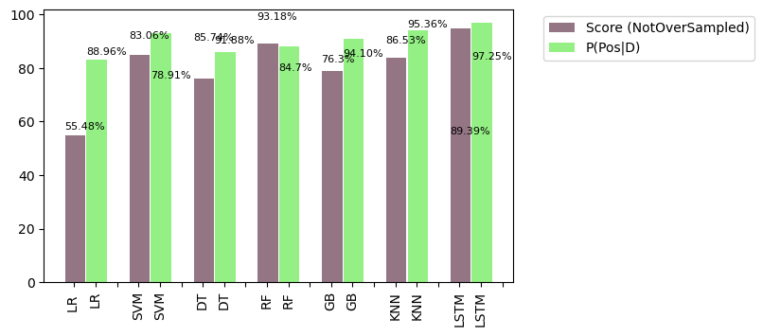
Training + Testing

Slide 8
THANK YOU !
Presented by : ZIYAD Mohssine, ZOGARH Meriem, OUKASSOU Youssef
Supervised by : Prof. QUAFAFOU Mohamed

